Slide 1
Scrabble Project
KAMMOUN YASSINE VICTOR BOURGAUD
1

Slide 2
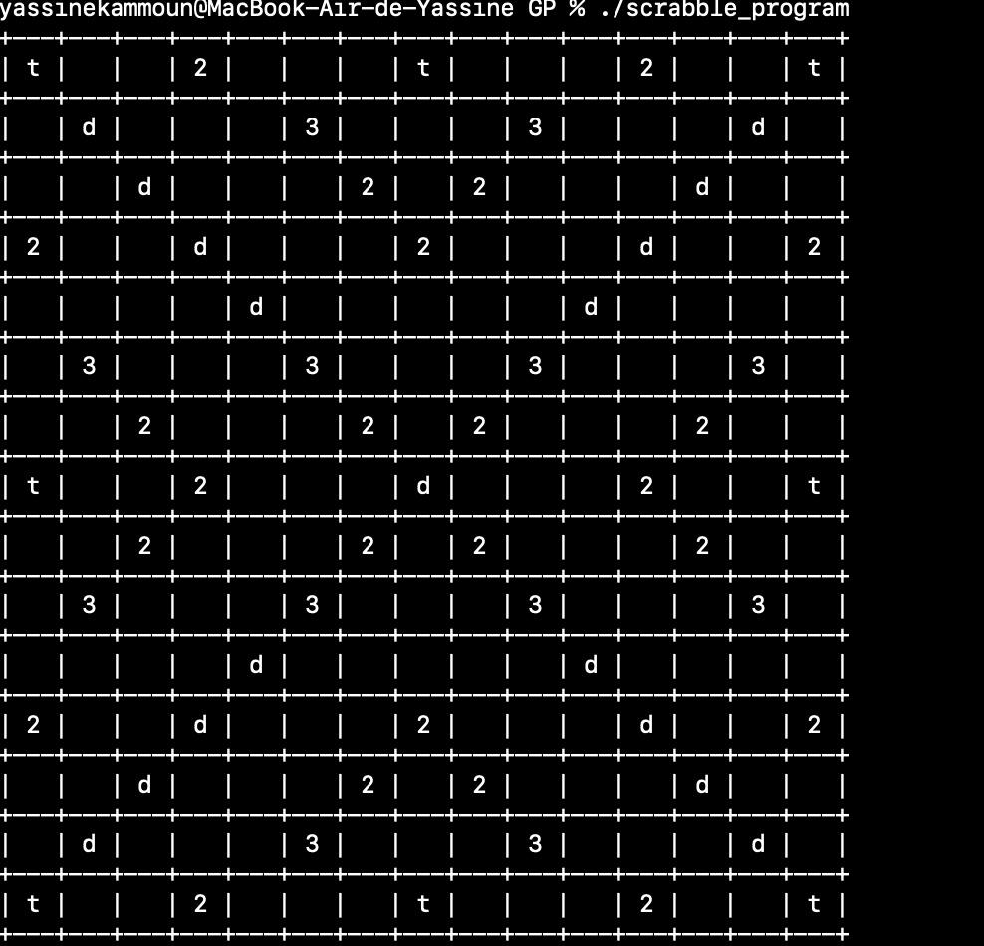
Introduction
Goal of the project : to write a C program that allows two players to play Scrabble
The program has many features that allow users to play Scrabble, such as :
Displaying the board
Placing words on the board
Calculating and keeping track of each player’s score
Checking if words are in the dictionary
Handling each player’s rack
2

Slide 3
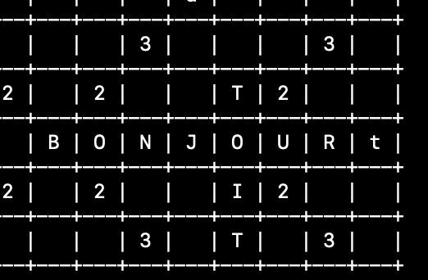
Word placement
Players provide a word, coordinates of its first letter on the board, and its orientation (horizontal or vertical)
The program then places the word on the board, as long as it :
does not exceed the boundaries of the board
does not overlap with another word unless the overlapping letters are the same
3

Slide 4
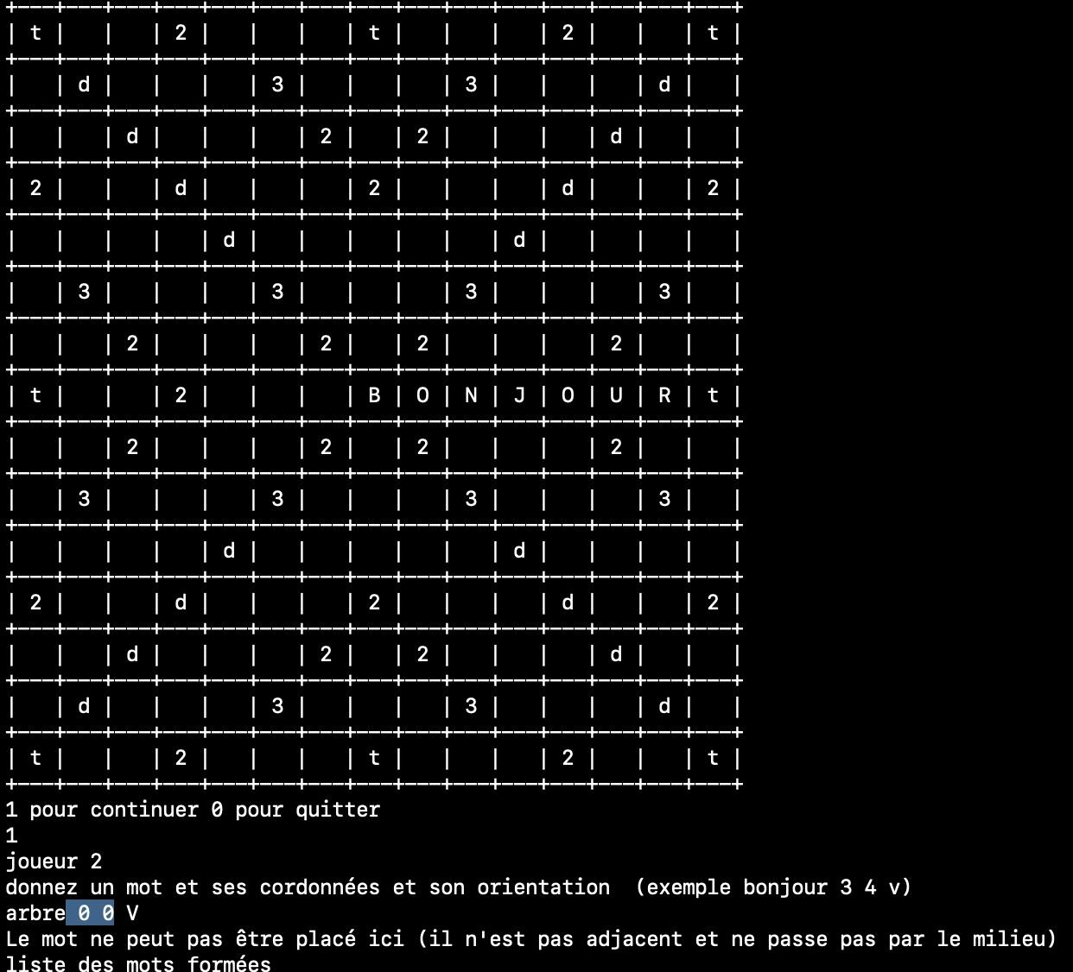
Adjacency
In addition, a word can only be placed on the board if at least one of its letters is adjacent to a letter from a word already on the board
This rule does not apply for the first word in a game, which instead must be placed in such a way that one of its letters is in the central space on the board
4

Slide 5
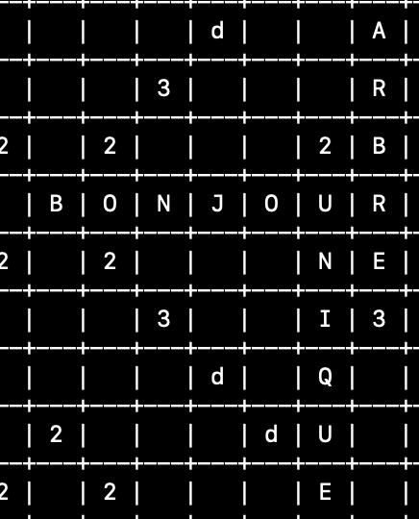
Word detection
Each time a player places a word on the board, the program detects every new word formed on the board.
Example : when placing a word next to another word, every two letter word created by adjacent letters is also detected
5

Slide 6
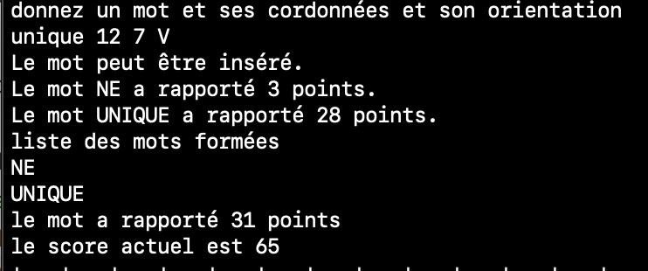
Point calculation
The program calculates the score for every new word detected :
each letter has its own value
the board has special spaces that can increase the number of points earned
the total of points of every word detected is added to the player’s score
6

Slide 7
Checking the dictionary
For each new word, the program checks if it is included in the dictionary of allowed words. If any new word is invalid, the player cannot make this move.
By default, the program uses the official French Scrabble dictionary from the FISF (Fédération internationale du Scrabble francophone).
The dictionary used can easily be changed simply by editing or replacing a text file, without the need to compile the program again
7

Slide 8
Rack management
At the start of a game, each player’s rack is filled with random letters and as long as there are still remaining letters, the racks are refilled at the start of each player’s turn
When a player tries to place down a word, they will only be able to do so if they have the necessary letters
A player will get an additional 50 points for placing all 7 letters on their rack in one play
When a player runs out of letters and there are no more letters to distribute, the game ends once the other player has one last opportunity to play
8

Slide 9
Project planning
We met several times with Mr. Yves Bertrand to allow him to check the progress of the project
Each of us has worked around 10 hours on the project
Task distribution :
Yassine : Initializing the game - Displaying the board - Calculating points
Victor : Placing words - Detection of new words
Still in development : Checking the dictionary - Rack management
9

Slide 10
Conclusion
The project is still in development but once completed, it will allow players to have a game of Scrabble without requiring a physical board or letters
The dictionary can easily be changed, and the game can therefore easily be played in multiple languages
Although the program only has a terminal display, it could easily be upgraded with the SDL library to enable a cleaner graphical display
10

